Slide 1


SMART NOTIFICATION SYSTEM FOR PPE ADHERENCE IN DESIGNATED AREAS
By thirtana bala

Slide 2
Introduction
Overview: Industrial environments like construction sites and manufacturing plants are high-risk areas where workers must adhere to Personal Protective Equipment (PPE) protocols to ensure safety. Non-compliance can lead to severe accidents and injuries.
Project Focus: The Smart Notification System is designed to improve PPE compliance by delivering real-time alerts to workers via wearable devices when they enter hazardous areas without the required protective gear.
Innovation: Integrates geofencing, wearable technology, and real-time notifications to proactively ensure worker safety.

Slide 3
Problem Background
PPE Compliance Challenges: Enforcing PPE protocols across large and dynamic work environments is challenging. Workers sometimes neglect PPE due to discomfort, a lack of awareness, or language barriers.
Human Factors: Issues like language diversity and restricted use of mobile devices can limit effective communication of safety alerts.
Safety Risks: Non-compliance with PPE increases the risk of workplace accidents, injuries, and even fatalities, highlighting the need for a more reliable enforcement mechanism.

Slide 4
Objectives of the Project
Primary Goal: Develop a Smart Notification System to monitor and enforce PPE compliance in specific, high-risk zones.
Improve Communication: Address communication challenges by providing real-time, language-agnostic alerts through wearable devices.
Accident Reduction: Reduce workplace accidents by ensuring workers are reminded and equipped with the appropriate PPE.
Compliance with CSN: This project aligns with the Computer Systems and Networks (CSN) curriculum by emphasizing network communication, data analytics, and IoT integration.

Slide 5
Scope
Focus Areas: The system is primarily designed for industrial sites, including construction, manufacturing, and port environments.
Limitations:
Signal Range: Limited to a radius of around 200 meters due to environmental obstacles like walls and machinery.
Device Usage: The system provides alternative alert methods (like wearable devices) to avoid issues with mobile gadget restrictions.
Human Factors: The effectiveness depends on worker compliance, training, and the overall safety culture of the organization.

Slide 6
System Components and Architecture
Wearable Devices: Smartwatches equipped with sensors and communication capabilities to detect location and provide alerts.
Sensor Network: Includes motion and proximity sensors or RFID readers strategically placed in designated zones to detect personnel.
Data Processing and Analysis: Utilizes machine learning algorithms for real-time hazard assessment and PPE recommendations.
Alert System: Real-time notifications alert workers to adhere to PPE protocols when they enter hazardous zones.
Integration: Seamlessly interfaces with existing safety infrastructure, such as access control systems, to maximize compatibility and reduce operational disruption.

Slide 7
Literature Review
Current Research: Discusses studies and projects that focus on using IoT, wearable technology, and data analysis to improve workplace safety.
Limitations of Existing Solutions: Challenges such as non-adaptive notifications, limited environmental monitoring, and a lack of personalized alerts.
Opportunities for Improvement: Expanding sensor capabilities, using predictive analytics for proactive safety measures, and enhancing integration with other industrial systems.

Slide 8
Methodology
Requirement Analysis: Initial consultations with stakeholders to understand PPE requirements and compliance challenges in different industrial zones.
System Design: Developing the system’s architecture, selecting appropriate wearable devices, and ensuring seamless integration.
Software Development: Implementing algorithms for tracking, alert generation, and device communication.
Hardware Integration: Ensuring compatibility between software components and wearable devices to optimize the user experience.
Testing and Validation: Conducting tests in simulated and real environments to evaluate system effectiveness in enforcing PPE adherence.

Slide 9
Design Specifications
Seed Xiao Module: Low-power microcontroller for wearable devices, offering compact size and efficient processing speed.
ESP32 Module: Core component of the transmitter, providing strong Wi-Fi and Bluetooth connectivity for IoT integration.
Passive Buzzer and Vibrating Motor: Devices to deliver auditory and tactile alerts, ideal for noisy environments.
Real-Time Clock and Sensors (LM35 and DHT11): For accurate timekeeping and environmental monitoring.
Li-Polymer Battery with Charging Module: Ensures reliable power for extended use in industrial environments.

Slide 10
Implementation Challenges
Interference and Signal Range: AM signals can be affected by interference, especially if another transmitter operates on the same frequency.
Device Durability: Wearable devices must withstand harsh conditions, including high temperatures and physical wear.
Human Compliance: Effectiveness depends on user acceptance and adherence to alerts, which may require training and a shift in workplace culture.

Slide 11
Testing and Validation
Simulated Environment Testing: Initial tests in a controlled environment to validate sensor accuracy, alert timing, and device response.
Real-World Testing: Deploying the system in active industrial sites to observe its performance in detecting PPE violations and generating alerts.
Evaluation Metrics: Tracking PPE compliance rates, response times to alerts, and reductions in safety incidents to measure success.

Slide 12
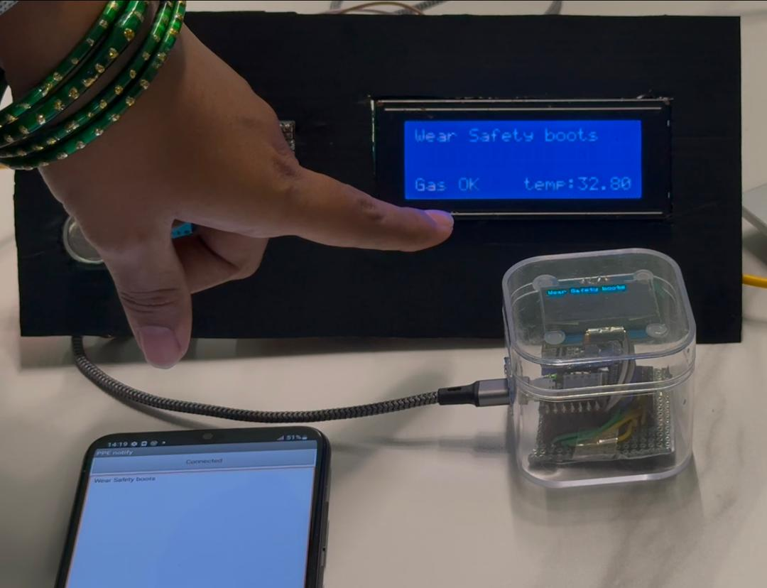
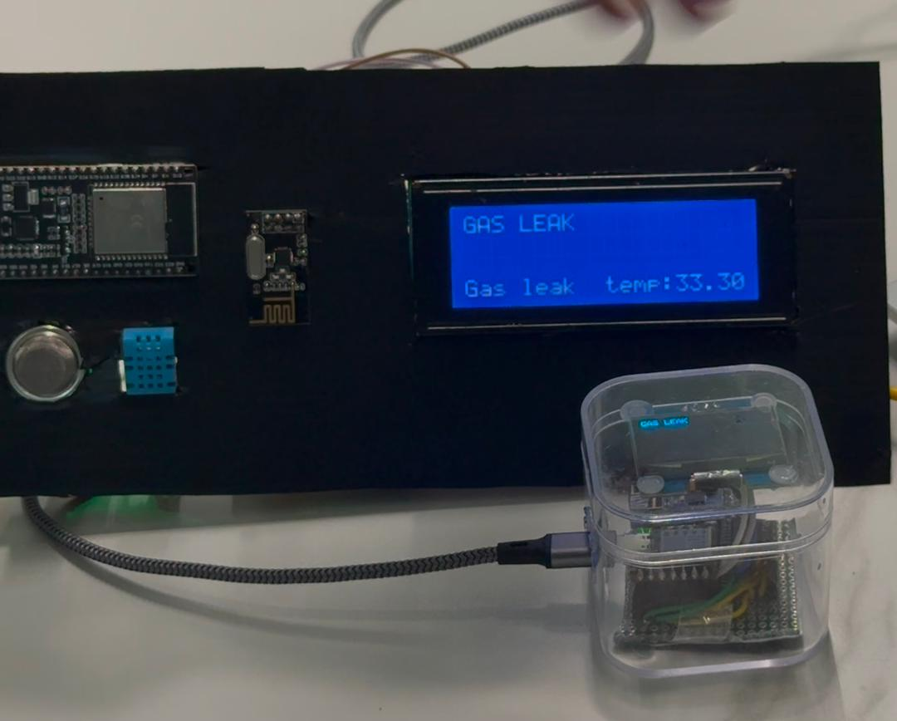
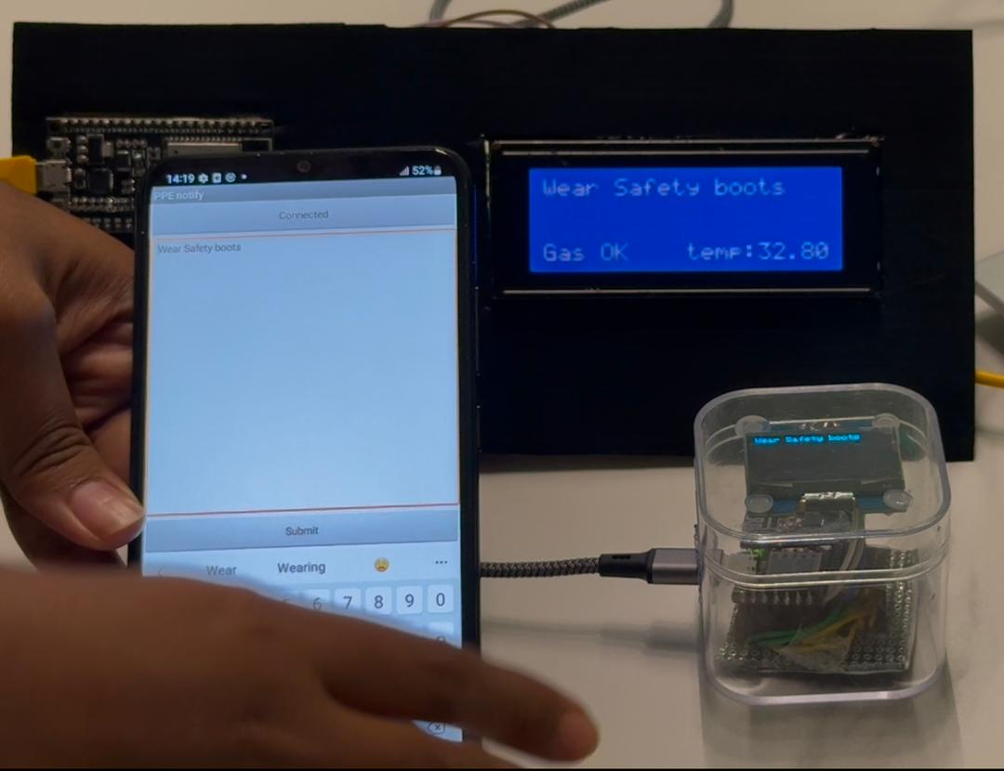
Testing and Result
Sent an alert message
When there is gas leakage
Send message from MIT App

Slide 13
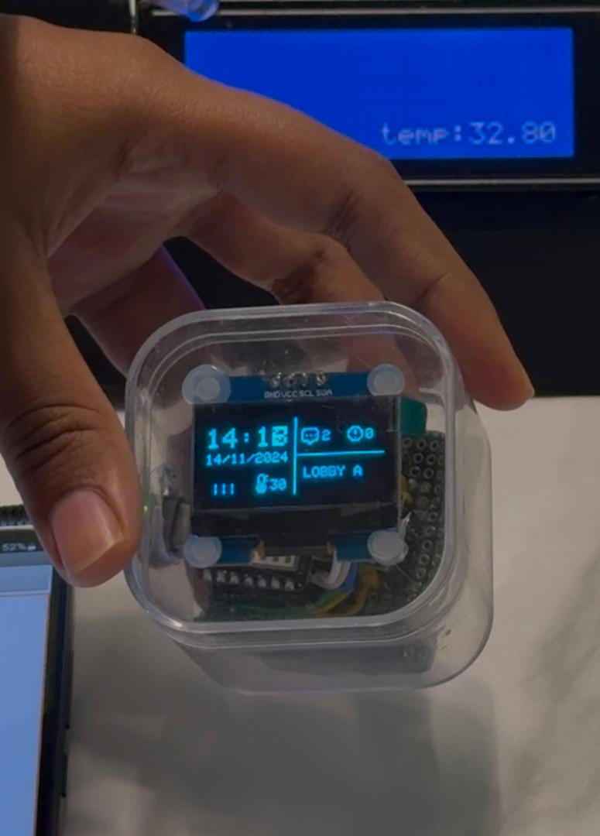
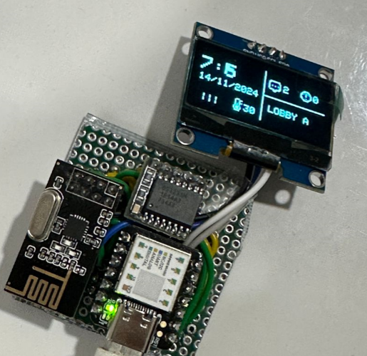
Testing and Result
Displays in wristband

Slide 14
Potential Impact and Benefits
Improved Safety Compliance: Real-time reminders increase PPE adherence, reducing accident rates.
Enhanced Data Insights: Provides data on PPE usage trends, helping companies optimize safety protocols and allocate resources effectively.
Promotes a Safety Culture: Encourages workers to follow safety protocols, contributing to a proactive safety-focused workplace.

Slide 15
Future Work and Improvements
Enhanced Language and Accessibility: Expanding language options and accessibility features for diverse workforces.
Augmented Reality (AR): Integrating AR could provide real-time visual alerts and guidance for workers.
Predictive Analytics: Utilizing historical data to anticipate safety risks, enabling more preventive action.

Slide 16
Conclusion
Project Summary: The Smart Notification System is designed to address the critical need for PPE adherence in industrial environments, enhancing safety and reducing accident rates through real-time alerts.
Impact and Future Direction: The project demonstrates the potential of IoT, wearable technology, and data analytics to transform workplace safety protocols. Future work will focus on further enhancing adaptability, accessibility, and predictive capabilities.

Slide 17

Thank You!

